Slide 1
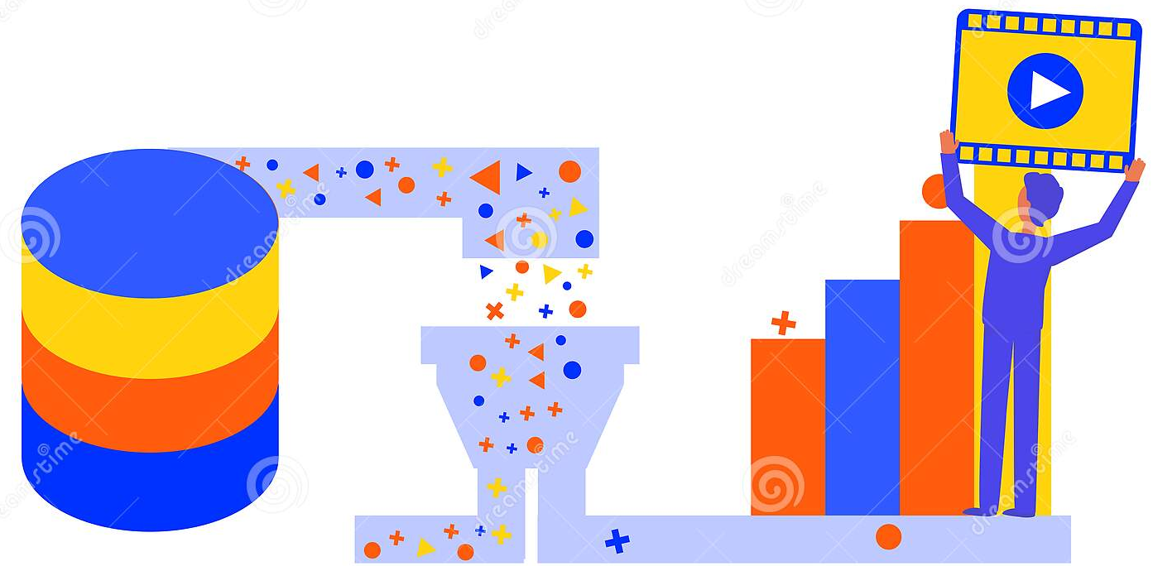
Movies Recommendation based on user demographics prediction
Age
Gender
Ethnicity

Slide 2
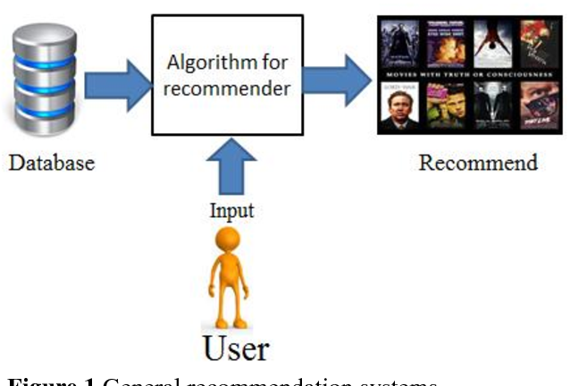
Objective

Slide 3
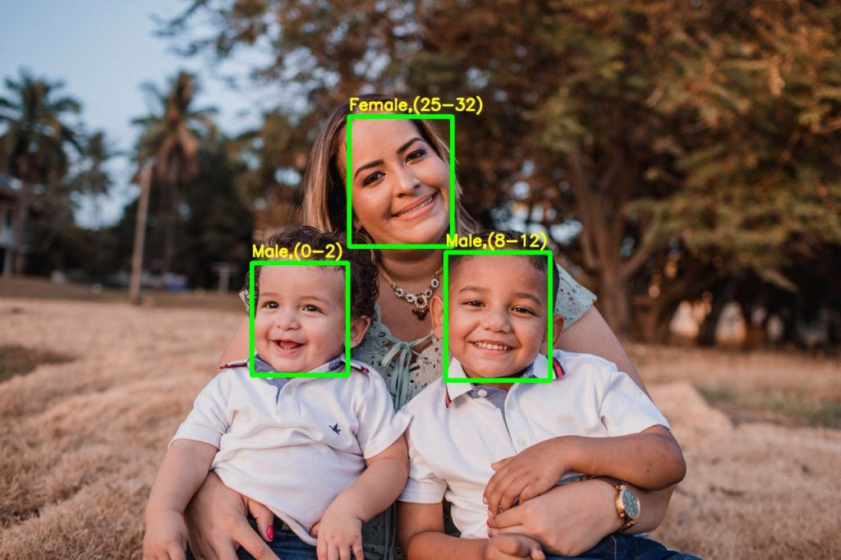
User demographics prediction

Slide 4
Content
Recommender system
Modeling
Deployment
Demo
conclusion
Age , Gender and Ethnicity from Kaggle
Movielens Dataset
Web Application
Summary
Future Work
Live Demo
Flow chart

Slide 5
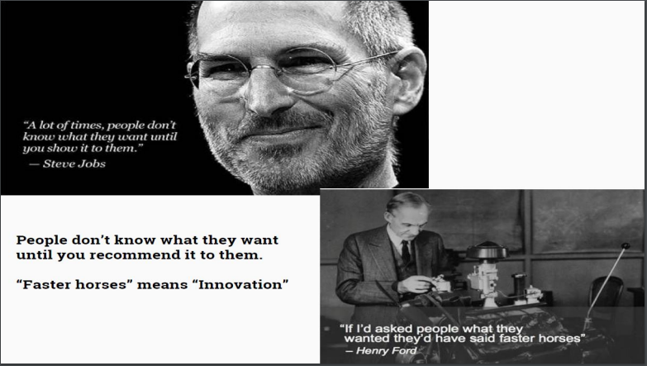
Why Recommendations?

Slide 6
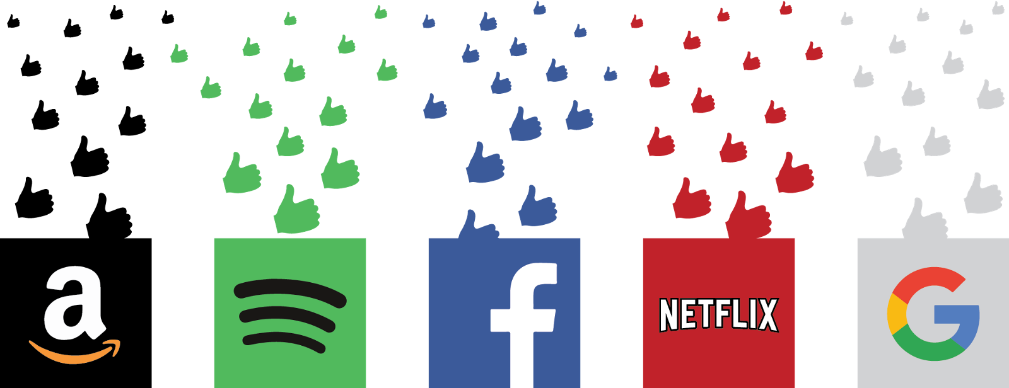
Recommender system applications:

Slide 7
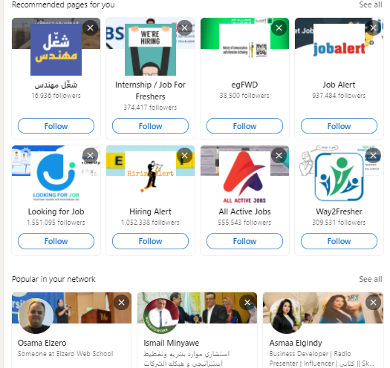
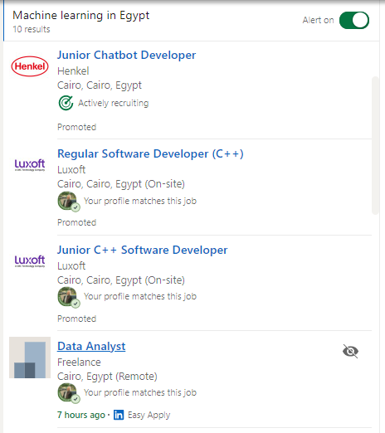
Recommendation in LinkedIn:

Slide 8
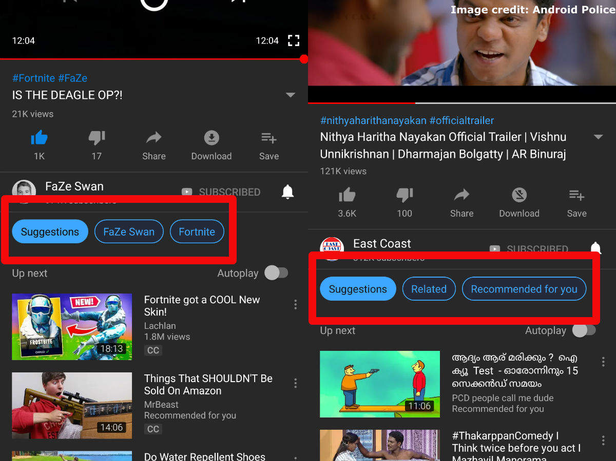
Recommendation in YouTube :

Slide 9
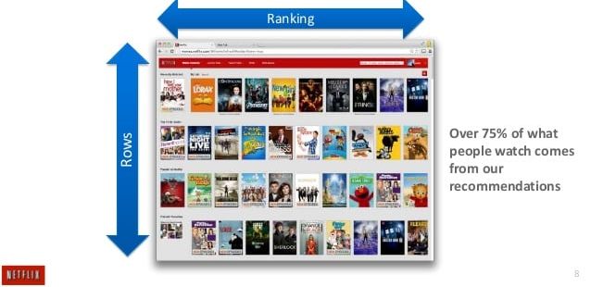
Recommendation in Netflix :

Slide 10
Types of Recommender Systems

Slide 11
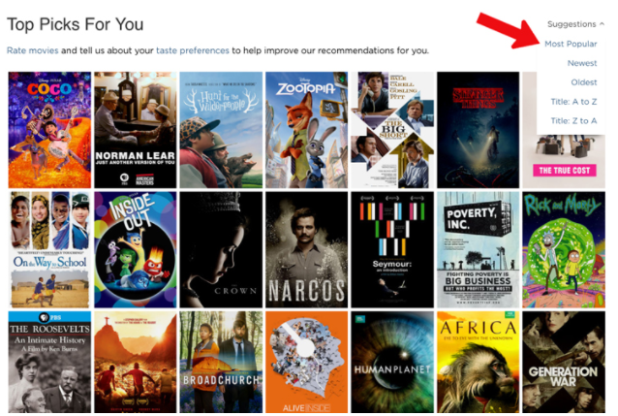
1. Rank-Based recommendations:

Slide 12
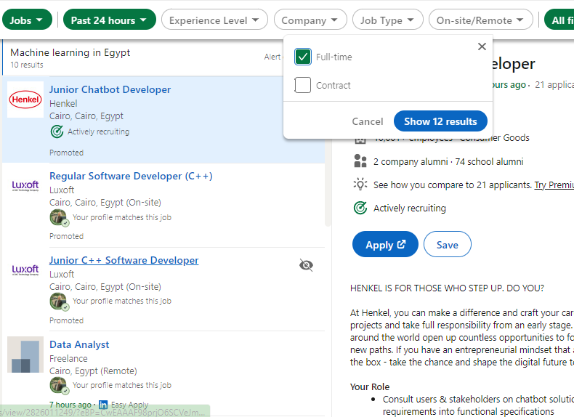
2. Knowledge-Based recommendations:

Slide 13
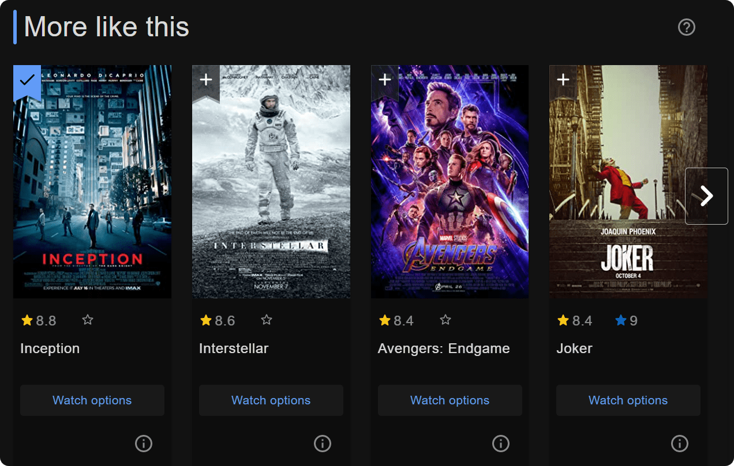
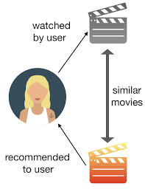
3. Content-Based recommendations:

Slide 14
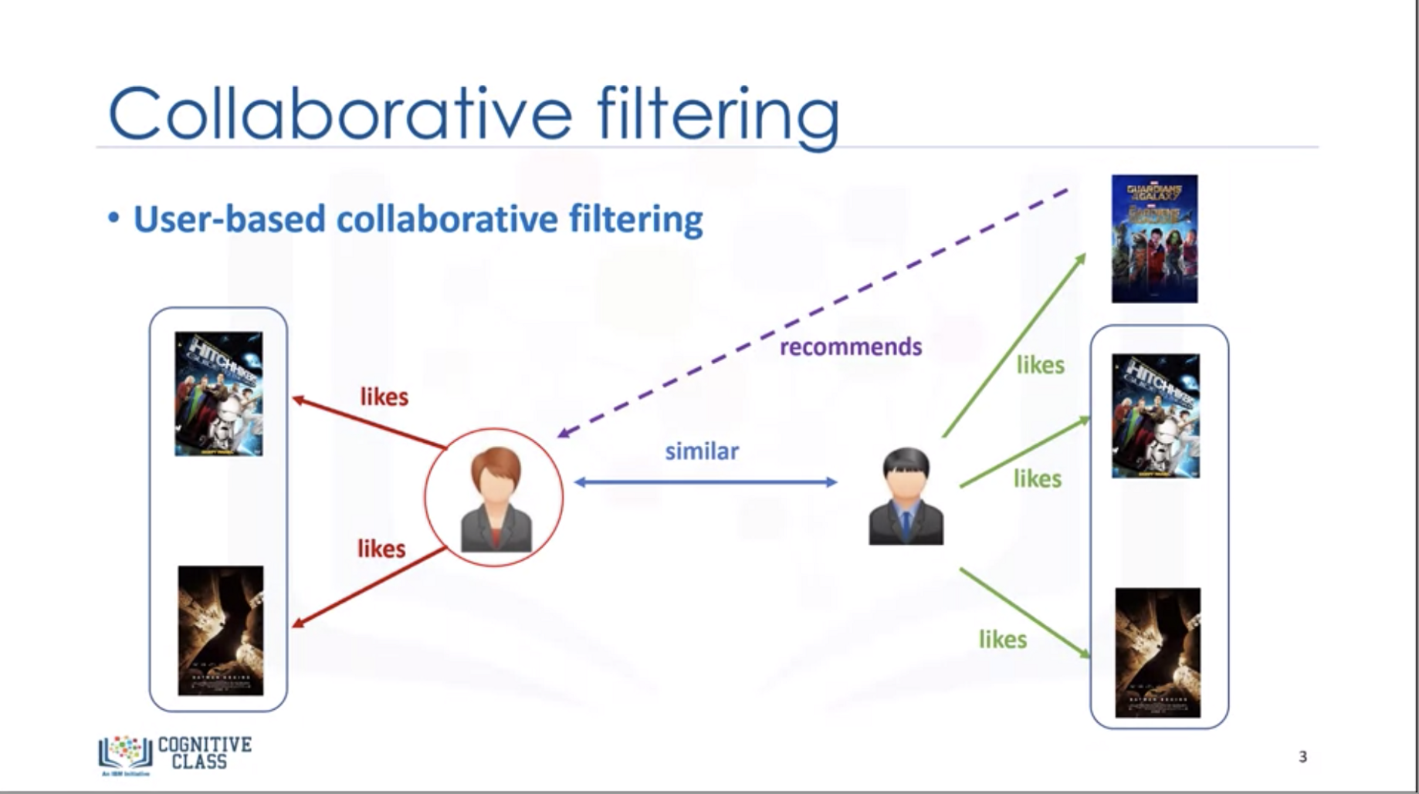
4. Collaborative-filtering recommendations:

Slide 15
Practical Approach

Slide 16
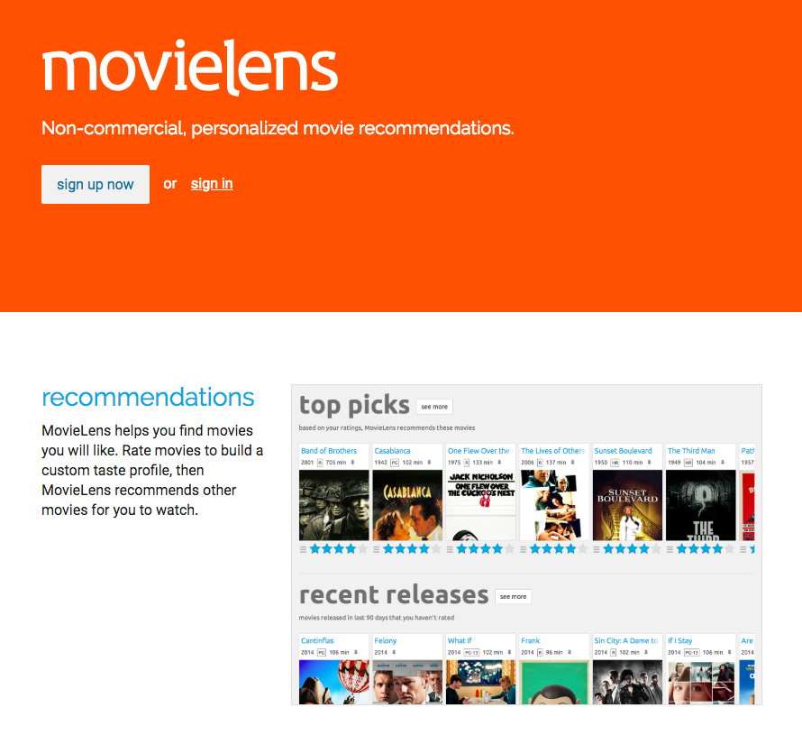
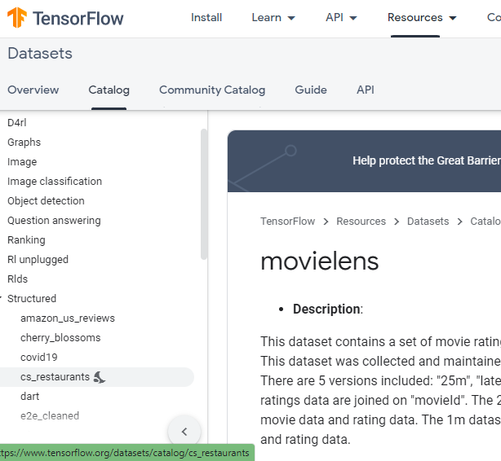
Dataset

Slide 17
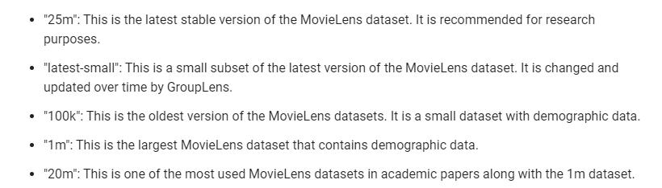
Movielens dataset versions

Slide 18
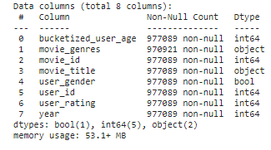
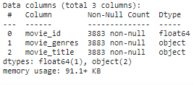
Data Exploration
MovieLens 1M ratings dataset. 1 million ratings from 6000 users on 4000 movies.
MovieLens 1M movies dataset. Has information about all movies found in ratings dataset

Slide 19
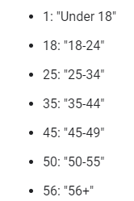
Data Exploration:
Bucketized user-age
Movie genre
User gender
0 : Action
1 : Adventure
2 : Animation
3 : Children
4 : Comedy
...
True : Male
False : Female

Slide 20
Data preprocessing

Slide 21
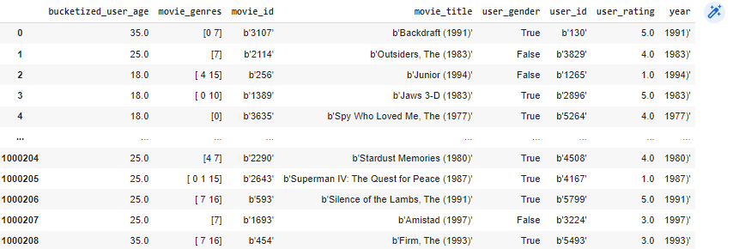
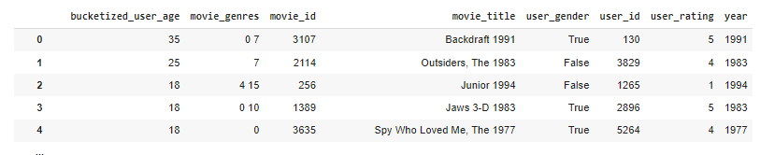
Data Cleaning

Slide 22
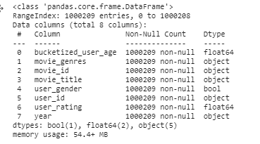
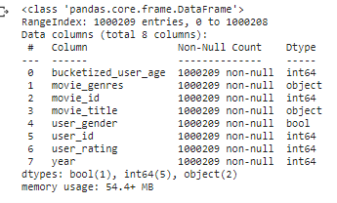
Type Conversion:

Slide 23
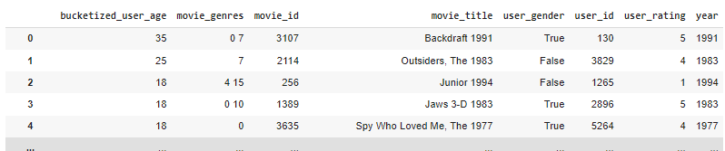
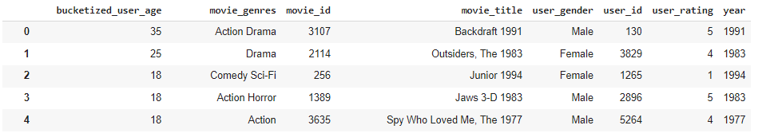
Data value correction

Slide 24
Recommendation

Slide 25

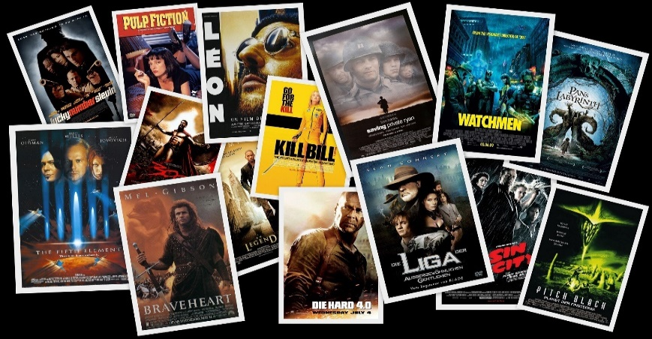
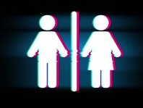
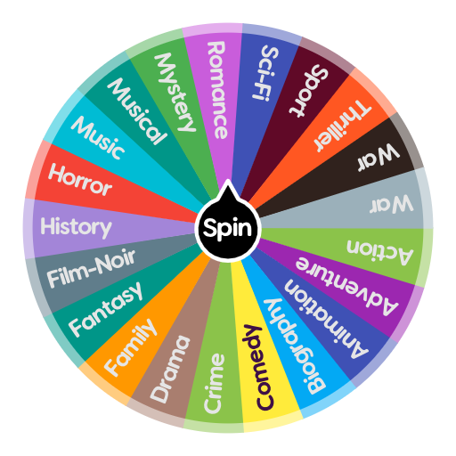
1. Knowledge-Based Recommender

Slide 26
Cont’d Knowledge-Based:
We will consider what is "most popular" based on the following criteria:
A movie with the highest average rating is considered best.
If movies are tied in their average rating and number of ratings, the ranking is determined by the movie that is the most recent rating.
A movie must have a minimum of 3.5 ratings to be considered among the best movies.

Slide 27
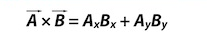
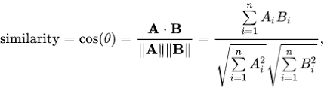
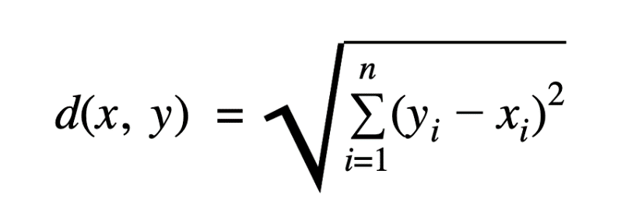
2. Content-Based Recommender
Similarity functions:
Use a similarity measure between movie features.
Dot product
Cosine similarity
Euclidean distance

Slide 28
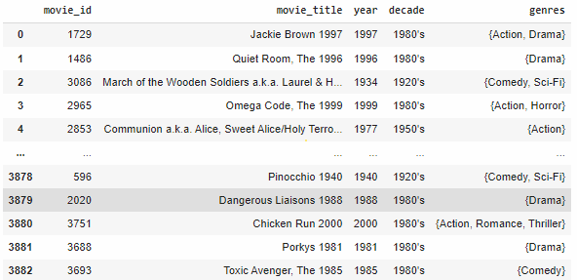
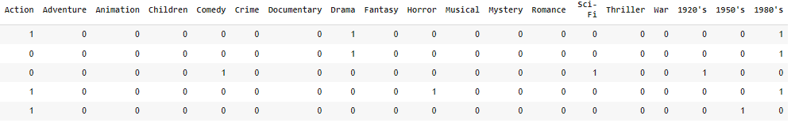
One-hot Encoding

Slide 29
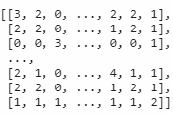
Find similarity
We use dot product to find similarities between movies.
We find the index of largest value in each row (Movie) to find the similar movies.
M1 M2 M3 . . . . . . . . . . . . Mn
M1
M2
M3
.
.
.
.
Mn

Slide 30
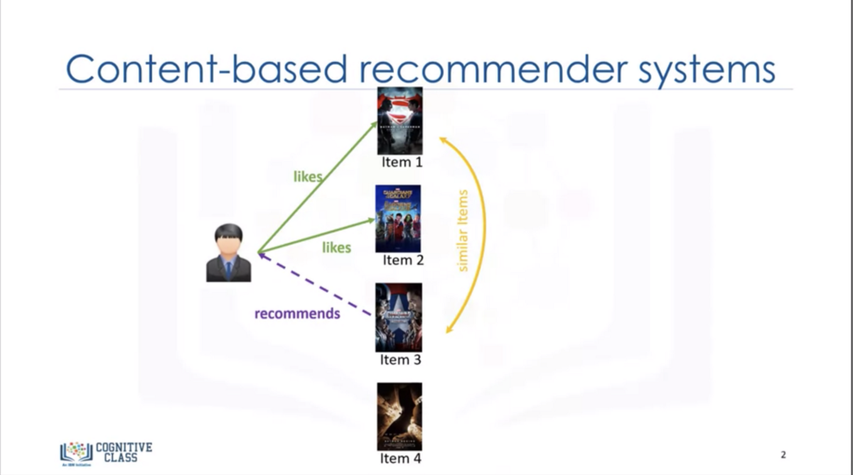
Movies Recommendation

Slide 31
Modeling

Slide 32
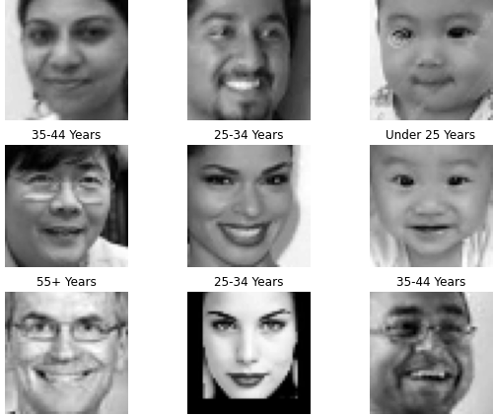
Dataset
Size:
23705 faces images
Features:
48 x 48 grayscale images
Labels:
Age
- [ 1 : 120 ] years old
Gender
- { 0: male, 1: female }
Ethnicity
- { 0: American-European, 1: negro(Black), 2: Japanese, 3: Indian, 4: Latina }

Slide 33
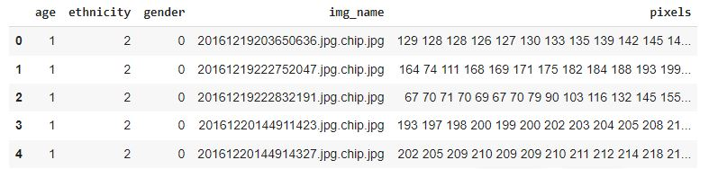
Dataset
Cont.

Slide 34
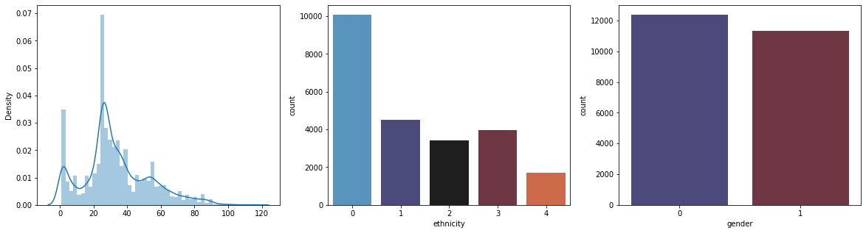
Distributions
Age Ethnicity Gender
age

Slide 35
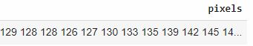
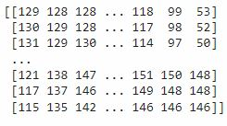
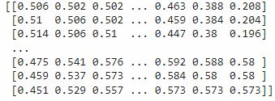
Preprocessing
Check for nulls (No nulls)
Pixels string split
Numpy array
Reshape (48 x 48)
Normalization ( 1 / 255)
Data Cleaning (checking blurred images)
Train, Validation & Test split

Slide 36
Model Architecture

Slide 37
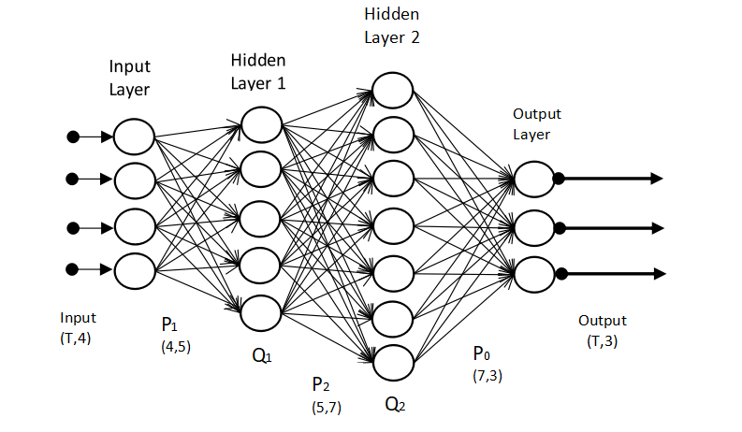

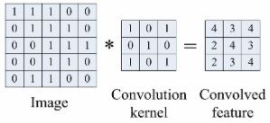
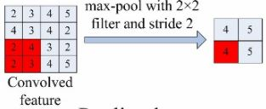
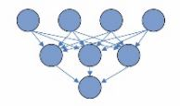
NNs vs. CNNs
Neural Network
(NN)
Convolutional Neural Network (CNN)
Conv. Layer
Pooling Layer
Fully Connected Layers

Slide 38
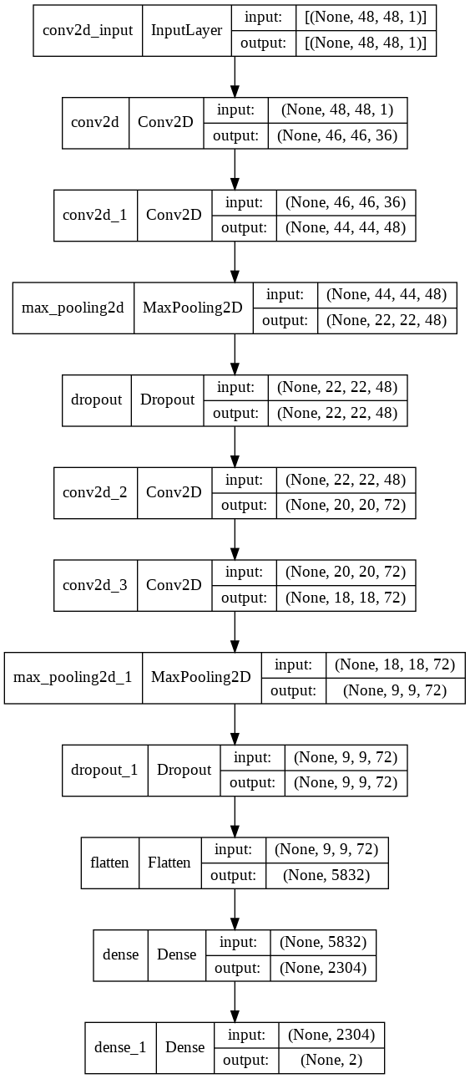
Gender Model
Model results:
 | Accuracy | Loss
Training | 0.93 % | 0.16
Val | 0.91 % | 0.24
Test | 0.89 % | 0.22
Model Architecture

Slide 39
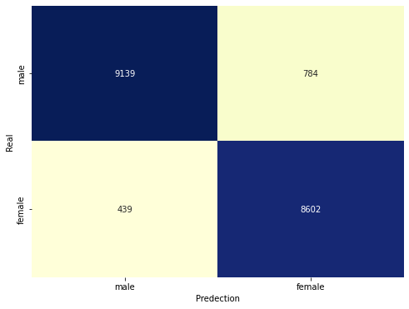

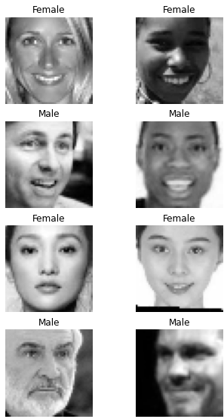
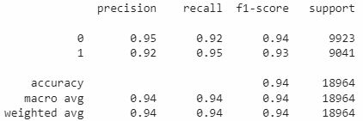

Gender Model
Cont.
Training
Testing
Confusion Matrix
Classification Report
Model Predictions

Slide 40

Ethnicity Model
Model results:
 | Accuracy | Loss
Training | 0.90 % | 0.38
Val | 0.69 % | 0.83
Test | 0.70 % | 0.81
Model Architecture

Slide 41





Ethnicity Model
Training
Testing
Cont.
Confusion Matrix
Classification Report
Model Predictions

Slide 42
Age Model

Slide 43

Age classes distributions

Slide 44

Age Model
Model results:
 | Accuracy | Loss
Training | 0.81 % | 0.47
Val | 0.74 % | 0.61
Test | 0.73 % | 0.65
Model Architecture

Slide 45





Age Model
Training
Testing
Cont.
Confusion Matrix
Classification Report
Model Predictions

Slide 46

Age classes down sampling

Slide 47

Age Model
Model results:
 | Accuracy | Loss
Training | 0.62 % | 0.89
Val | 0.52 % | 1.05
Test | 0.51 % | 1.09
Model Architecture

Slide 48





Age Model
Training
Testing
Cont.
Confusion Matrix
Classification Report
Model Predictions

Slide 49
















Other Dataset For Age
Size:
185632 faces images
Features:
128 x 128 RGB images
Labels:
Age
- [ 1 : 100 ] years old

Slide 50

Preprocessing
Check for nulls (No nulls)
loading images & convert it to grayscale.
Apply face detection on images .
Resizing to (48 x 48)
Save to CSV
Pixels string split.
NumPy array.
Reshape (48 x 48)
Normalization ( 1 / 255)
Data Cleaning (checking blurred images)
Train, Validation & Test split.

Slide 51

Dataset after preprocessing
Cont.

Slide 52


Age classes down sampling
Before down sampling
After down sampling

Slide 53
Age Model
Model results:
 | Accuracy | Loss
Training | 0.46 % | 1.22
Val | 0.44 % | 1.25
Test | 0.44 % | 1.27
Model Architecture

Slide 54





Age Model
Training
Testing
Cont.
Confusion Matrix
Classification Report
Model Predictions

Slide 55
Age Model
Training
Testing
Cont.
Confusion Matrix
Classification Report
Model Predictions

Slide 56
Deployment

Slide 57
Deployment
Tools
Flask Framework
Backend
Frontend
Diagrams
Use Case Diagram
Sequence Diagram
Flow Chart Diagram
Demo
Future Work

Slide 58


Flask
Framework For Building Web applications in python
Install flask
Install virtual env
Create directory

Slide 59


Slide 60
Why Bootstrab
Easy to use and Quick to learn.
Speed of Development
Consistent Design and common Component
Wide Browser Completely
Responsive Framework

Slide 61


Slide 62

MYSQL
A database is a separate application that stores a collection of data. Each database has one or more distinct APIs for creating, accessing, managing, searching and replicating the data it holds.
Wampserver (phpMyAdmin )
Connection Databaes
ERD 3 Tables
Users_info
Movies
Users _ interactions

Slide 63



ERD

Slide 64


Slide 65


Slide 66


Slide 67
Sequence Diagram

Slide 68

Prediction

Slide 69

Recommendation

Slide 70
Flow Chart

Slide 71
Take Photo
def take_photo_timer_detect_face(photo_path):
True
No face detected
OR
More than one face detected
Start
Input
Photo path
Load face detection model
Open camera
Save photo
False
timer >= 0
False
end
timer = 3 sec
True
Display each frame with the countdown
Find faces using the model
Get the area of the face
timer = timer - 1

Slide 72
Make Predictions
def model_pred(MODEL_PATH, MODEL_LABELS, photo_path):
Input model path, model labels and photo path
Start
Read photo
Resize the photo
Load the model
end
Return the predictions
Get the equivalent label for the prediction
Get the predictions

Slide 73
Send Mail
def send_recommendations_to_mail(user_info, recommendations):
Input
user info and recommendations
Send email
Start
Create email msg.
end

Slide 74
DEMO

Slide 75
Conclusion

Slide 76
Future Work
Age model Manual Data Cleaning
Various recommender systems approaches
Ethnicity
Collaborative filtering
Implicit Ratings
User interaction record
Production

Slide 77
References

Slide 78

Any Questions

